Slide 2
Building apps & games for Xbox One using UWP - Build once and target many
Simon (darkside) Jackson
Game Development Evangelist
ZenithMoon Studios and Xbox MVP

Slide 3
Agenda
What is the Universal Windows Platform (UWP)
What has UWP ever done for us?
Getting to know the Tools
UWP on Xbox getting started
Unity Demo
MonoGame Demo
Paths to publishing
Key differences with Native

Slide 4
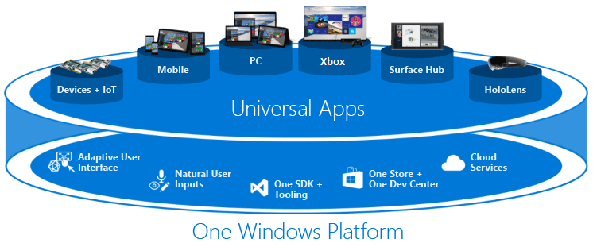
Universal Windows Platform

Slide 5
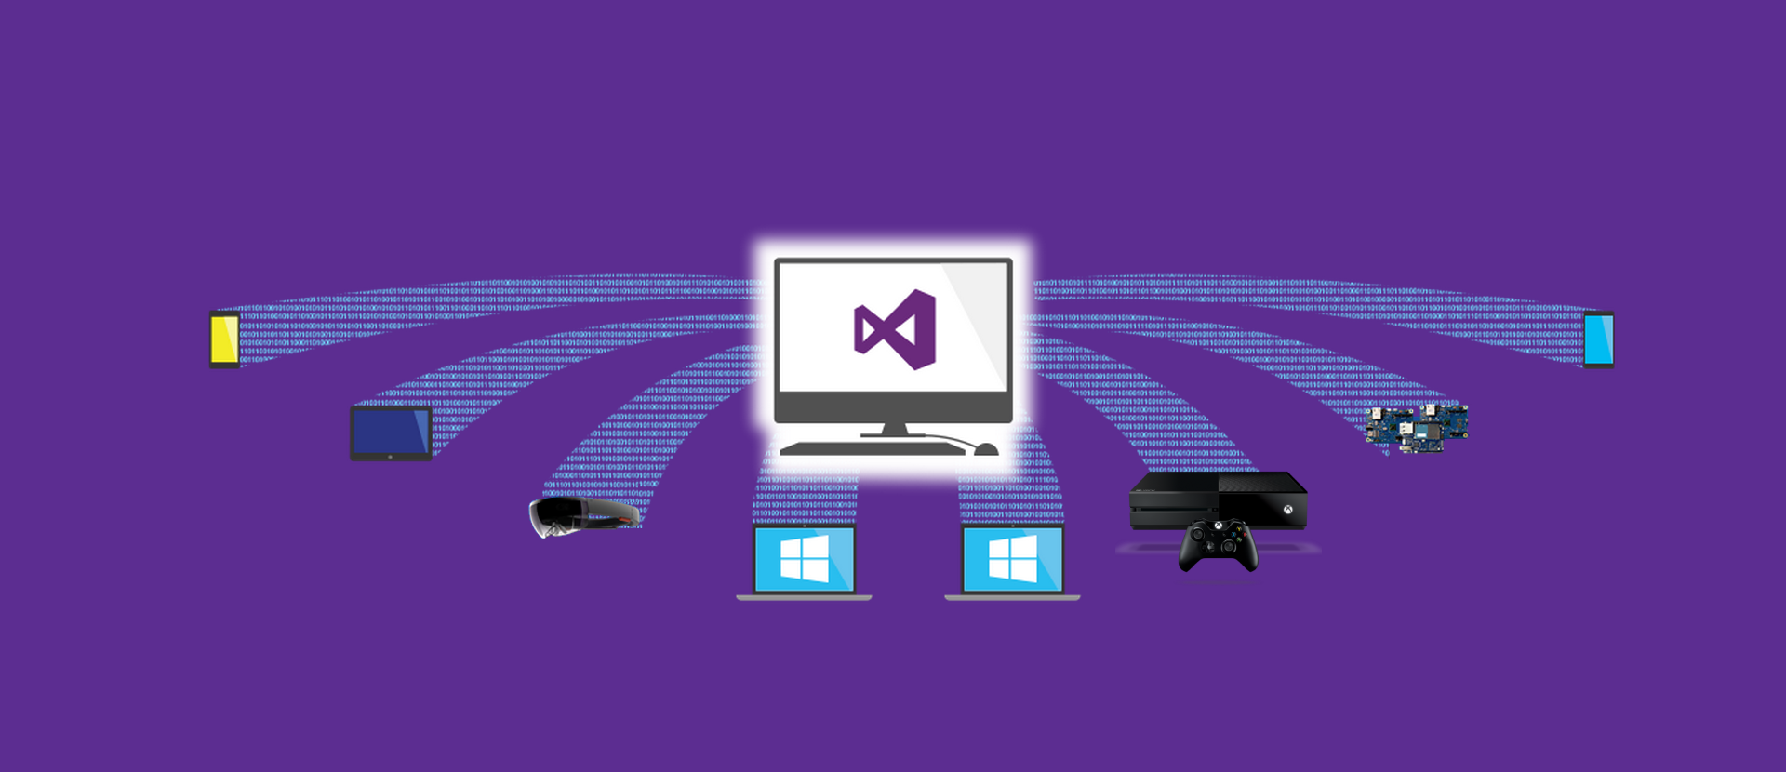
Building once, targeting many

Slide 6
Building once, targeting many, with extensions
Mobile
Tablet
HoloLens
Laptop
Desktop
Xbox
IoT
Mobile

Slide 7


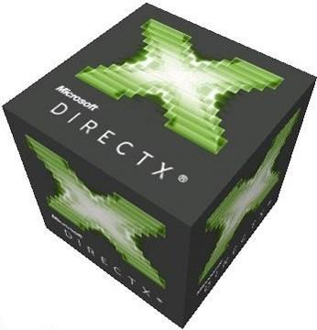




A growing family

Slide 8
Getting started with UWP on Xbox
What do you need?
Xbox Retail kit
Dev Mode Activation app installed (available on Xbox store)
PC (or Virtual Machine) running Windows 10
Visual Studio Community 2015 (or higher)
Windows UWP SDK
Tool / framework / engine of your choice
Free time

Slide 9
Spinning up your development environment

Slide 10
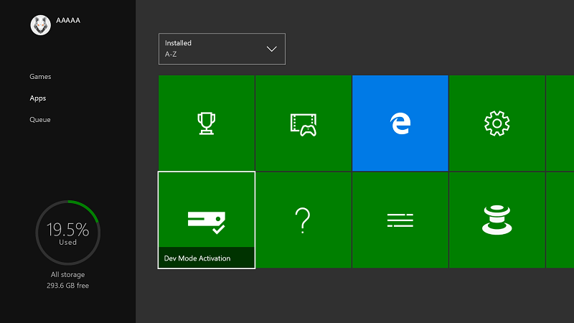
Install the Dev Mode Activation app

Slide 11
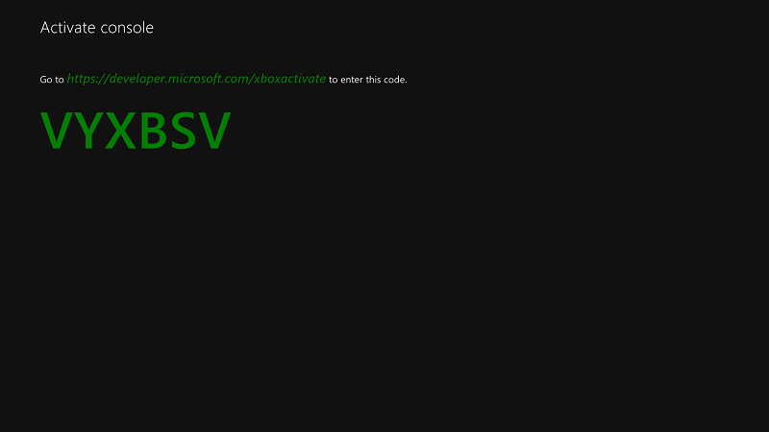
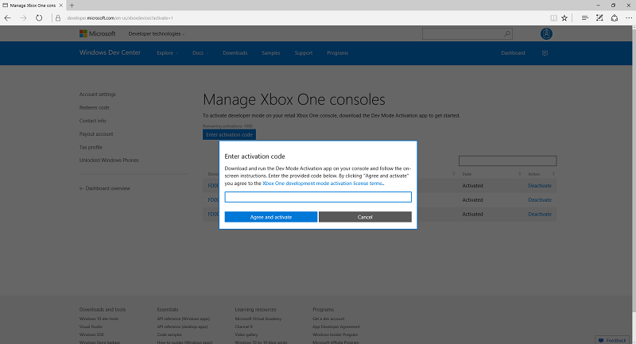
Activate on first run

Slide 12
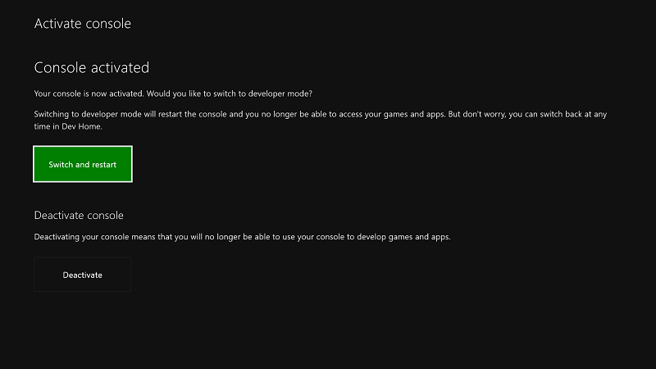
Switch and Restart

Slide 13
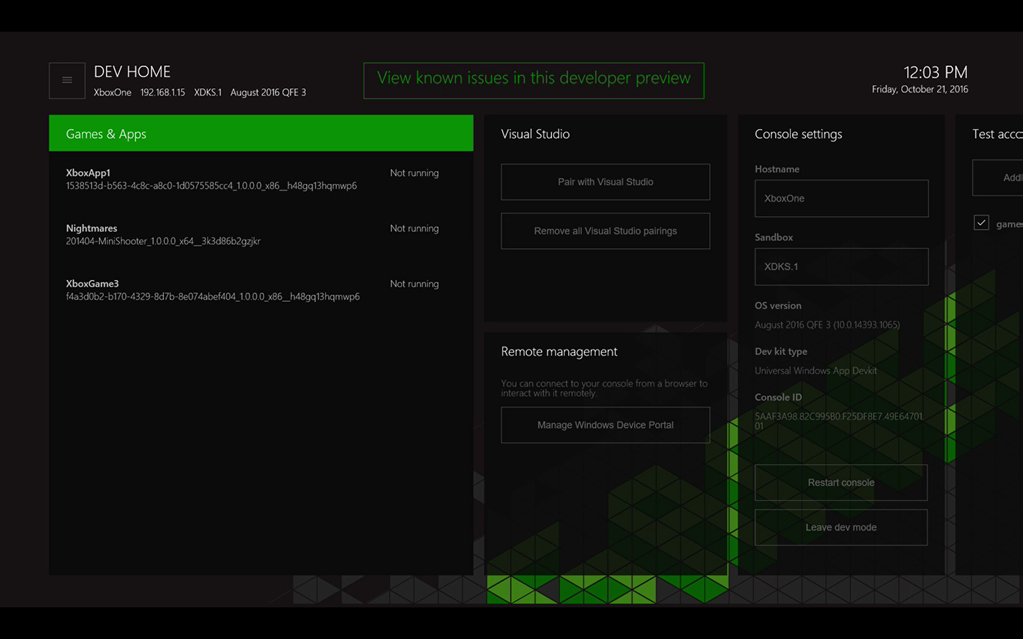
Xbox Developer app
Tool

Slide 14
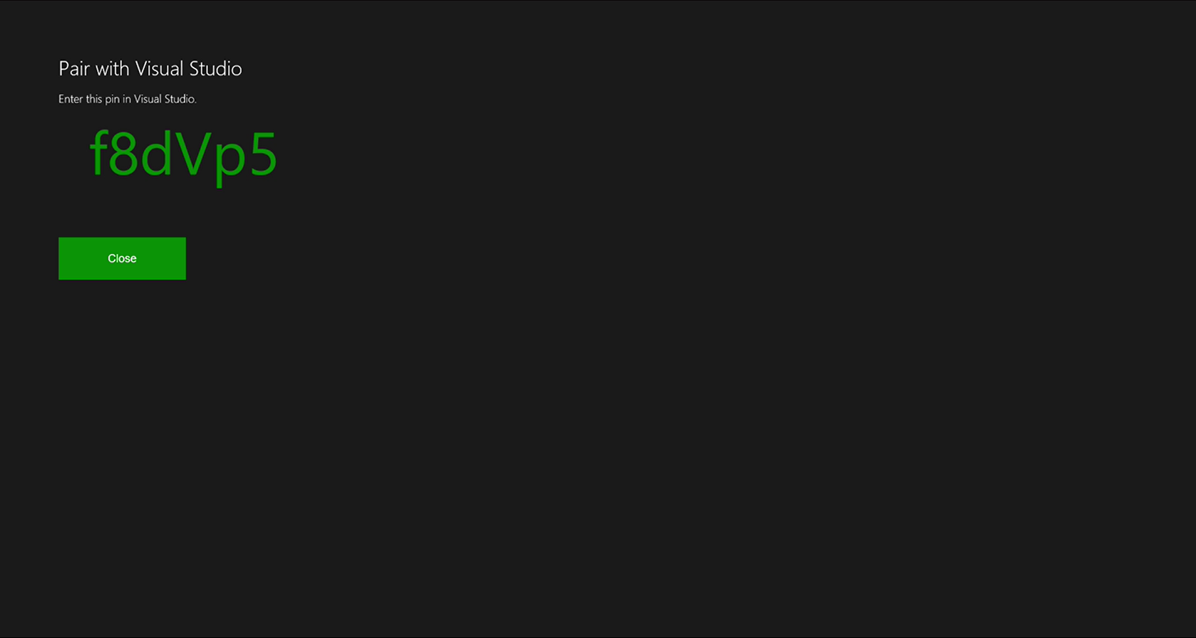
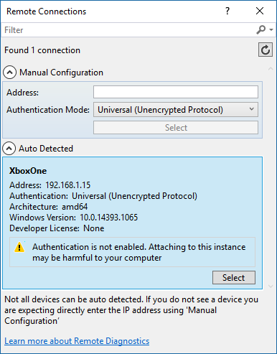
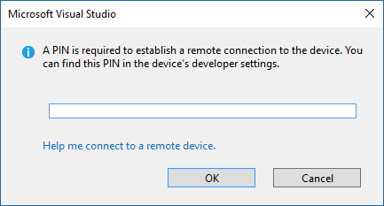
Visual Studio Remote Deploy
Tool

Slide 15
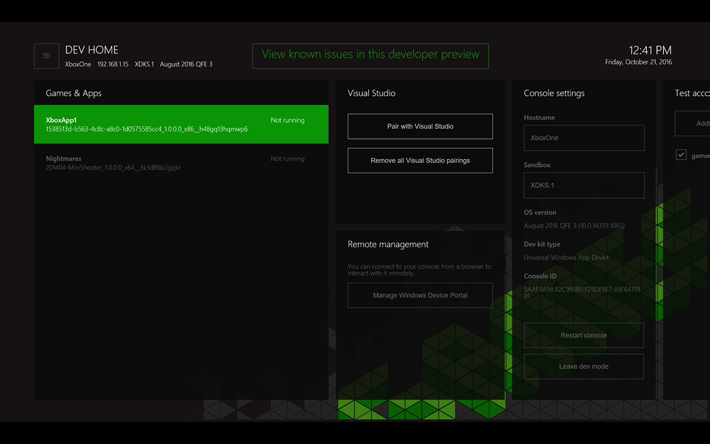
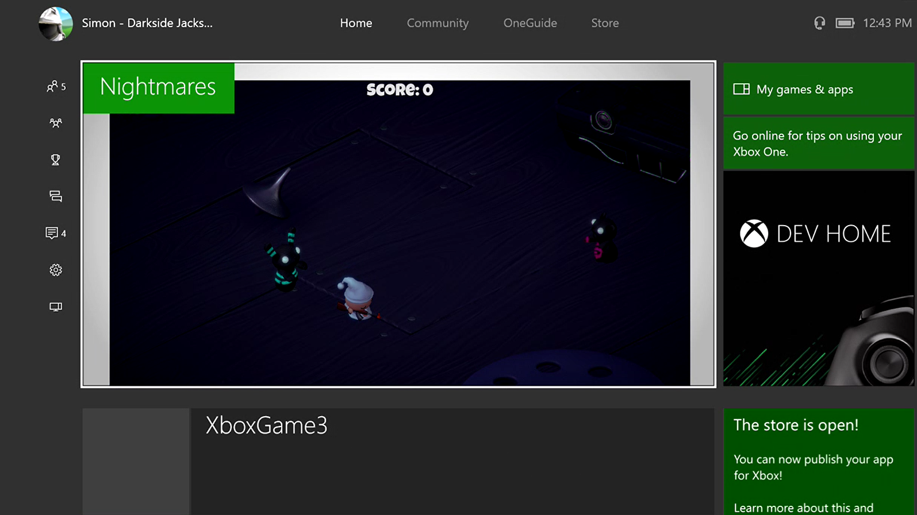
Deployed and running
Tool

Slide 16
Spinning up your development environment
Install Dev APP
Activate
Restart
Launch Dev App
Tools IP
Connect VS
Deploy
Total Start-up time – 5 Minutes

Slide 17
Demos

Slide 18

Unity Demo

Slide 19

MonoGame Demo

Slide 20
Getting your game on the Store

Slide 21
What next?
Publishing requires sign up to ID@Xbox
http://www.xbox.com/id
Focus on Windows 10 first
Apply for Xbox later
Presence is everything

Slide 22
Key differences between UWP & Native
UWP
Works on all Xbox One’s
Shorter dev cycle
Easier test and deployment
More targets
Some memory constraints
Native
Requires Dev kit
Full resource access
C++ required for tools
Xbox Only
Tougher certification Req’s

Slide 23
Questions?
Get Publishing!

